Slide 1

Statistics Introduction
Santosh chhatkuli

Slide 2
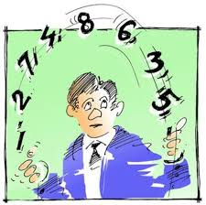
What is Statistics?
Statistics is a science which is concerned with proper collection of data, organization of these data into manageable and presentable form, analysis and interpretation of data into meaningful conclusions.
Thus statistical investigation has following steps:
Step 1: Collection of data
Step 2: Organization of data
Step 3: Presentation of data
Step 4: Summarization of data numerically
Step 5: Analysis of data
Step 6: Drawing conclusion and making inferences

Slide 3
Population
Draw Sample
Collect data from sample
Organization of data
(Data systematization)
Analyze the organized and cleaned data
Draw conclusions and inferences

Slide 4
Functions of statistics
Present the facts and figures in a definite form / Express facts relating to different phenomena in numbers
Help in presenting complex data in a suitable numerical figures, tabular, diagrammatic and graphical form for easy and clear comprehension of the data.
Facilitates comparison between groups or samples
Predicting the occurrence of an event / Measure uncertainty
Help establishing functional relationship between variables / Model Building
Helps in drawing Inferences about population parameters from the sample data (Testing of hypothesis and estimation of parameters)
Help in forecasting trend and tendencies / Develop forecasting models
Help in quality control of goods produced and services provided
Help in plans, policies and making decisions
Help in monitoring and evaluating ongoing projects

Slide 5
Limitations of statistics
It deals with aggregate of value and it doesn’t give any specific recognition to the individual value
It is best suited to study quantitative data. There is less usage of statistics when data is qualitative.
Statistical conclusions are not universally true. Statistics laws are true only on average
Statistical analysis and interpretations requires a high degree of skill and understanding of subject
Statistics can be misused / Statistics results might be misleading

Slide 6
What is data?
Data is raw facts and figures. Data consist of information coming from observations, counts, measurements or responses. Data are the values that the variables can assume. Collection of data is called data set and a single observation is called a data point or data value or datum.
Data
Process
Information
Knowledge

Slide 7
Data according to source
Sources of data can be classified into two types. They are:
Primary Source
Secondary Source
Primary data sources include information collected and processed by the researcher using surveys, experiments, observation technique etc.
Secondary data sources include information retrieved through preexisting sources such as books, journals, thesis, investigation reports, news articles, publications etc.
Primary Data Sources in IT: Ecommerce Data, Social Media Data, Browsing Data, IOTs Data. Internet Usage Data, Registration Data, Signups etc.
Secondary Data Sources: Databases, Relational Databases, Webpages, Blogs etc

Slide 8
Primary Data
Data collected from primary source
First-hand information collected by an investigator
Collected for the first time
Original and more reliable
Need processing
Secondary Data
Data collected from secondary source
Second-hand information
Already presented in the form of figures, graphs and tables.
May be in published or unpublished forms
Do not need to process, already processed

Slide 9
Advantages of Primary Data
Primary data is specific to the needs of the researcher at the moment of data collection. The researcher is able to control the kind of data that is being collected.
It is accurate as compared to secondary data. The data is not subjected to personal bias and as such the authenticity can be trusted.
The researcher exhibit ownership of the data collected through primary research. He or she may choose to make it available publicly, patent it, or even sell it.
Primary data is usually up to date because it collects data in real-time and does not collect data from old sources.
The researcher has full control over the data collected through primary research. He can decide which design, method, and data analysis techniques to be used.
Disadvantages of Primary Data
Primary data is very expensive compared to secondary data. Therefore, it might be difficult to collect primary data.
It is time-consuming.
It may not be feasible to collect primary data in some cases due to its complexity and required commitment.

Slide 10
Advantages of secondary data
It is economical because someone else has already collected the data
Various data regarding the topic can be found easily
Data can be collected in short period of time
Disadvantages of secondary data
Data may be obsolete, unreliable and not authentic
The information which are needed by researcher might be found or in the form he/she needed
The researcher/analyst didn't participated in the data collection process, he/she doesn’t know exactly how it was done.
Researchers may have to deal with irrelevant data before finally finding the required data

Slide 11
Branches of statistics
Inferential statistics (Modern Statistics)
Descriptive Statistics
Descriptive Statistics can be defined as those methods involving the collection, presentation and characterization of a set of data in order to describe the various features of that set of data properly. These methods can either be graphical or computational.
Commonly used descriptive statistics include graphs and charts, frequency tables, range, mean, mode, median, standard deviation etc.
Inferential Statistics can be defined as those methods that make possible the estimation of a characteristic of a population or the making of decision concerning a population based only on sample results.
Make inferences and predictions about population based on sample of data taken from the population in question. Since our decision from sample is not always true we have to use language of probability to tell how likely our results are true and can be generalized.
Statistical concepts required: Defining population, Drawing random sample, use of appropriate sampling technique, probability distribution, sampling distribution etc.

Slide 12
Population: A population may be defined as any identifiable and well-specified group of individuals or objects that interests us theoretically. It is a collection of all subjects (human or otherwise) we are studying and about which are trying to draw conclusions.
Types:
Finite vs Infinite population
Homogeneous vs Heterogeneous population
Target population vs Accessible population
Examples
Citizens of Nepal
Parts from a production line
Subscribers of the Nepal Telecom mobile service
Subscribers of World Link communication for internet service
Account holders of Himalayan Bank
Students studying BScCSIT course of Tribhuvan University
Customers of the DARAZ ecommerce company
Members of the club

Slide 13
Sample : A sample is a group of subjects selected from population for analysis. It is a finite part of a statistical population whose properties are studied to get the information about the whole. We study the properties of the sample and get information about the population.
Sampling: The process of drawing sample from the population

Slide 14
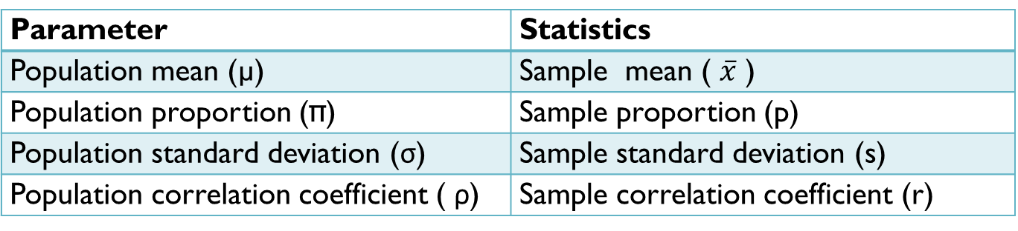
Parameter: Population is described by Parameter. A parameter is a summary measure that describes characteristics of an entire population. It is a numerical characteristic of the population. Usually, we don’t know the real value of a parameter and it is estimated from sample.
What proportion of subscribers of NTC who use android phone?
What is the average height of female in the age group 20-25 in Nepal
Note: Greek letters are used to symbolize population information.
Statistic: Sample is described by Statistic. A statistic is a summary measure that is computed to describe a characteristic from only a sample of the population. It is a numerical characteristic of the sample.
The value of statistic is different from sample to sample and it depends upon type of sampling used, size of the sample used etc.
Parameter | Statistics
Population mean (µ) | Sample mean ( $\overline{x}$ )
Population proportion (π) | Sample proportion (p)
Population standard deviation (σ) | Sample standard deviation (s)
Population correlation coefficient ( ρ) | Sample correlation coefficient (r)

Slide 15
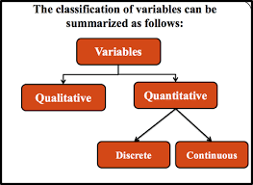
variables
A variable is a characteristic that varies from one person or thing to another. Variable whose values are determined by chance are called random variables. Data are values of variable.
Types of Variable
There are two types of variable.
Categorical variable (Non-Numerical variable) (Qualitative Variable)
Numerical variable (Quantitative Variable)

Slide 16
Numerical Variable Example
Height of students
Age of account holders
No. of devices linked to an email address
Internet usage in GB
No. of people in each households
No. of goals in a football match
Blood glucose level of a person
Scores in exam
No. of Facebook visits per day by a person
Maximum temperature over the month
IQ score
Temperature
Categorical Variable Example
Gender of the person
Blood group type
Type of mobile operating system
Computer literacy
Religious Belief
Type of Bank Account
IQ category
Economic status
Weight category
Type of school
Marital status

Slide 17
Level of measurement
Variables are measured in one of the following measurement scale.
Nominal scale
Ordinal scale
Interval scale
Ratio scale
Nominal Scale: The lowest measurement scale is the nominal scale. Nominal scales are used for labeling variables, without any quantitative value. Gender of the person : Male (1) or Female (2)
Ordinal Scale: With ordinal scales, the order of the values is what’s important and significant, but the differences between each one is not really known. How do you feel today: Very unhappy (1), Unhappy (2), OK (3), Happy (4), Very happy (5)
Interval Scale: Interval scales are numeric scales in which we know both the order and the exact differences between the values. Example: Temperature, SAT score, GRE score, Marks of students etc
Ratio Scale: The highest measurement scales is the Ratio Scale. This scale is characterized by the fact that equality of ratios as well as equality of intervals may be determined. The main feature of the ratio scale is that the scale has an absolute or true zero of measurement. Example: Weight, Height, CPU Usage etc.

Slide 18
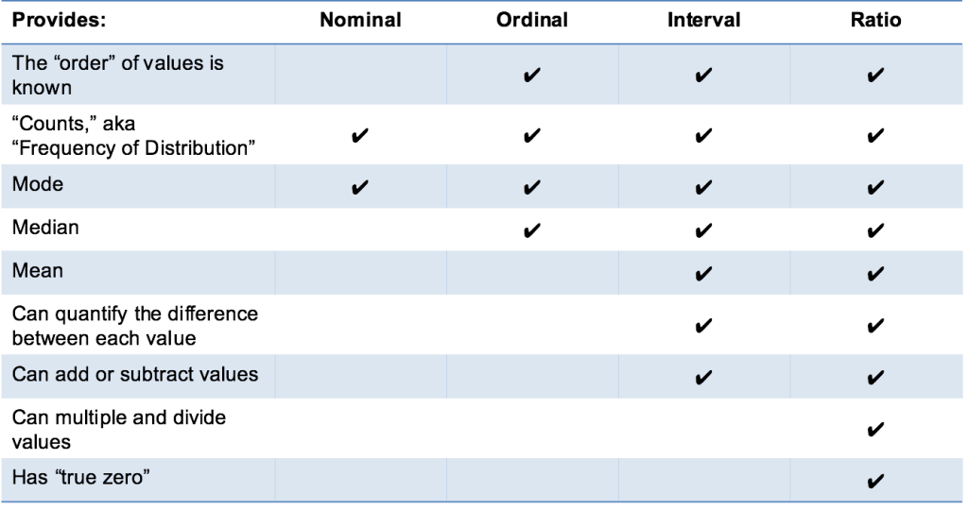

Slide 19
Data preparation
Data preparation is a crucial step in statistical analysis and involves several stages to ensure that the data is clean, consistent, and ready for analysis.
Data preparation includes:
Data Collection: This involves gathering data from various sources relevant to your analysis. Data can come from databases, surveys, experiments, or other sources such as databases, APIs, or files etc.
Data Integration: This involves merging of data from multiple sources into a single dataset, ensuring consistency in format and structure. It also involves addressing any discrepancies or conflicts between datasets, such as different units or naming conventions.
Data Cleaning: Data cleaning involves identifying and handling missing values, outliers, and inconsistencies.
Handle Missing Values: Identify missing data and decide on a strategy to handle it (e.g., deleting or imputing or estimating missing values).
Detect and Correct Errors: Identify and correct inaccuracies or inconsistencies (e.g., typos, incorrect entries).
Remove Duplicates: Identify and remove duplicate records to avoid redundancy.
Formatting and Standardizing: Ensure consistency in data formats (e.g., date format, units) throughout the dataset.

Slide 20
Data Transformation: This step involves manipulating the data to prepare it for analysis. Common transformations include:
Deriving new variables: Create new variables based on existing ones (e.g., calculating ratios or percentages)
Binning: Grouping continuous data into categories.
Encoding categorical variables: Transforming categorical data into numerical formats for statistical modeling. (eg level encoding, one-hot encoding etc.)
Normalize/Standardize Data: Adjust data to a common scale without distorting differences in the ranges of values
Data Validation: After cleaning and transforming, it's crucial to check if the data meets your analysis requirements. This may involve running statistical tests or visualizing the data to identify any remaining issues.
Data Documentation:
Document Procedures: Keep detailed records of all data preparation steps, including transformations, cleaning and decisions made.
Ensure Reproducibility: Make the data preparation process transparent and reproducible for future analysis. It help in understand how the data was prepared for analysis.

Slide 21
Importance of statistics in Business
Statistics plays a crucial role in business by enabling data-driven decision-making and improving overall efficiency.
Areas of business:
Marketing
Finance
Management
Accounting

Slide 22
Role of Statistics in Marketing
Market Research: Helps businesses identify customer preferences and market trends through surveys, focus groups, and data analysis.
Customer Segmentation: Divides customers into groups based on age, income, behavior, etc., for targeted campaigns.
Advertising Effectiveness: Measures how well an ad campaign performs, ensuring efficient spending.
Sales Forecasting: Predicts future sales trends to set realistic targets and plan inventory.
Competitor Analysis: Assists in understanding competitors' strategies and market share.

Slide 23
Role of Statistics in Finance
Investment Analysis: Assesses the risk and return of investments using statistical models like regression and probability.
Risk Management: Evaluates financial risks (e.g., credit risk, market risk) and helps mitigate them.
Portfolio Optimization: Helps in diversifying investments to maximize returns and minimize risks.
Budgeting and Forecasting: Uses historical data to predict future cash flows and set financial goals.
Stock Market Analysis: Tracks trends and predicts market behavior based on statistical patterns.

Slide 24
Areas:
Strategic management
Operations management
Financial management
Human resource management
Marketing management
Supply chain and logistics management
IT management
Project management
Risk management
Innovation and change management
Role of Statistics in Management
Performance Evaluation: Tracks employee productivity and organizational performance using KPIs (Key Performance Indicators).
Decision Making: Provides data-driven insights to solve business problems and improve operations.
Resource Allocation: Optimizes the use of resources like manpower, materials, and funds.
Project Management: Predicts project timelines and resource needs using statistical tools.
Change Management: Analyzes the impact of organizational changes on employees and processes.

Slide 25
Role of Statistics in Accounting
Fraud Detection: Identifies anomalies in financial transactions and detects fraudulent activities.
Auditing: Uses statistical sampling to verify financial accuracy and compliance.
Cost Analysis: Tracks costs and identifies areas to cut expenses while maintaining efficiency.
Financial Reporting: Helps prepare accurate reports using data summaries and analysis.
Trend Analysis: Evaluates financial trends over time to make predictions and assess financial health.

Slide 26
Application areas of statistics in IT
Simulation and modelling: Computer simulation, the use of a computer to represent the dynamic responses of one system by the behavior of another system modeled after it. A simulation uses a mathematical description, or model, of a real system in the form of a computer program.
Artificial Intelligence: The theory and development of computer systems able to perform tasks normally requiring human intelligence, such as visual perception, speech recognition, decision-making, and translation between languages.
Statistics and machine learning : Machine Learning is a sub-area of artificial intelligence, whereby the term refers to the ability of IT systems to independently find solutions to problems by recognizing patterns in databases. In other words: Machine Learning enables IT systems to recognize patterns on the basis of existing algorithms and data sets and to develop adequate solution concepts. Therefore, in Machine Learning, artificial knowledge is generated on the basis of experience.
Tasks by Machine Learning:
Finding, extracting and summarizing relevant data
Making predictions based on the analysis of data
Calculating probabilities for specific results
Adapting to certain developments autonomously
Optimizing processes based on recognized patterns

Slide 27
Computational Statistics: Computational statistics, or statistical computing, is the interface between statistics and computer science. It is the area of computational science specific to the mathematical science of statistics.
Data Mining: Data mining is a process of discovering patterns in large data sets involving methods at the intersection of machine learning, statistics, and database systems
Data Warehousing: A Data Warehousing (DW) is process for collecting and managing data from varied sources to provide meaningful business insights. A Data warehouse is typically used to connect and analyze business data from heterogeneous sources. The data warehouse is the core of the BI system which is built for data analysis and reporting.
Neural Network: Neural networks are being used in areas of prediction and classification, the areas where statistical methods have traditionally been used.

Slide 28
Web Analytic: Web analytics is the measurement, collection, analysis and reporting of web data for purposes of understanding and optimizing web usage
Visual Analytics: Visual Analytics is the science of analytical reasoning supported by interactive visual interfaces.
Test Analytics: Text analytics is the automated process of translating large volumes of unstructured text into quantitative data to uncover insights, trends, and patterns. Combined with data visualization tools, this technique enables companies to understand the story behind the numbers and make better decisions.
Business Analytics: Business analytics is the process of collating, sorting, processing, and studying business data, and using statistical models and iterative methodologies to transform data into business insights. The goal of business analytics is to determine which datasets are useful and how they can be leveraged to solve problems and increase efficiency, productivity, and revenue.
Design and analysis of algorithm: Design and Analysis of Algorithm is very important for designing algorithm to solve different types of problems in the branch of computer science and information technology.
Data Structure and Algorithms: A data structure is a named location that can be used to store and organize data. And, an algorithm is a collection of steps to solve a particular problem. Learning data structures and algorithms allow us to write efficient and optimized computer programs.

Slide 29
Computer performance/Hardware Bench-marking: Benchmarking is usually associated with assessing performance characteristics of computer hardware, for example, the floating point operation performance of a CPU
Software performance/Software Bench-marking: One of the most important things that a business who relies on software development can do is to establish a software performance benchmarking system. This is used to determine how a system performs when tested under a particular workload. It can test stability, responsiveness, effectiveness, speed or something else. It can also be used to investigate, measure, validate or verify other parts of your code, such as the scalability or usage.
Manufacturing and Quality Control: Statistical process control is a method of quality control which employs statistical methods to monitor and control a process. This helps to ensure that the process operates efficiently, producing more specification-conforming products with less waste.
Stochastic process and queuing theory: The word stochastic is jargon for random. A stochastic process is a system which evolves in time while undergoing chance fluctuations. Queueing theory is the mathematical study of waiting lines, or queues. A queueing model is constructed so that queue lengths and waiting time can be predicted.

